Slide 1
2024

Slide 2
Marketing Tech Award 2024
The Marketing Tech Award 2024 will once again be presented during the Marketing Tech Summit on October 8th and 9th at the Bolle Festsäle.
The deadline for submissions August 16, 2024
Please submit entries to anja.ehrke@marketingtechlab.de

Slide 3
Marketing Tech Award 2024
Submission Process
The application phase for the Marketing Tech Award 2024 runs until August 16th. After the submission deadline, all applications will be evaluated by a carefully selected jury. The evaluation criteria of the awards jury can be found on the following slides. Based on the evaluations, the jury will select three finalists who will present their cases at the Marketing Tech Summit on October 8th and 9th. Following the presentations, the final evaluation will be conducted by the summit participants. Subsequently, the Marketing Tech Award 2024 will be presented.
We will inform the finalists of their participation in due time.

Slide 4
bis 16.08.
23.09.
07.10.
Jury-Auswahl
16.08.
26.09.
08.10.

Slide 5
Bewertungskriterien
The jury will evaluate your Marketing Tech Stack based on these criteria:
Completeness of the picture: ChatGPT Data Management Data Analytics CRM/CDP (Customer Relationship Management / Customer Data Platform) Marketing Planning and Resource Management (including Operations & Finance) Personalization Components Shop Web/App Components (E-Commerce) Orchestration (Content, Bots, Product Data, Marketing Automation) Campaign and Channel Management (e.g., Display, SEA, Affiliate, Social, SEO, etc.)
Traceability & Clarity of the Image and Description including Mention of KPIs
USP or Highlight of the entire stack or individual elements
Individuality of the technology components (in-house developments, collaboration with startups)
Integration level at a data level
Integration and Automation level at a process level
Personalization and Segmentation level
Maturity level of the stack
Presentation of the Case
Future topics

Slide 6
1
2
3
4
5
Your Marketing
Tech Stack
Image
Your Marketing Tech Stack description
Your highlight of the stack
Integration, automation, personalization level
Developments in 2025/2026
Please upload an image of your Marketing Tech Stack (inspirations can be found at www.marketing-tech-award.de)
Please describe on 3-5 pages what makes up your Marketing Tech Stack or why you chose these elements.
What is your personal highlight of your tech stack that you are particularly proud of, or what is your best practice and why?
Please describe to us to what extent your stack also contains individual elements, how the components are integrated on a data and process level, and what the level of personalization and segmentation is.
Are you planning any changes to your stack for 2025/2026? If so, what are they, what is the goal, and why?

Slide 7
1
Your Marketing Tech Stack Image
Please present in the visualization of your Marketing Tech Stack all components as images with logos or names of the tools and tech building blocks - either by functional areas, value creation, customer journey phases, or an alternative representation. The Tech Stack should include components from:
Data Management
Data Analytics
CRM/CDP
Marketing Planning and Resource Management (including Operations & Finance)
Personalization Components
Shop Web/App Components (E-Commerce)
Orchestration (e.g., Content, Bots, Product Data, Marketing Automation)
Campaign and Channel Management (e.g., Display, SEA, Affiliate, Social, SEO, etc.)
…

Slide 8
2
Ihre Marketing Tech Stack Description
Please explain your Marketing Tech Stack to us in 3-5 slides and describe why it is structured this way. You can use the following questions as guidance:
What are the company challenges that you solve with the Tech Stack?
For what purpose do you use each component, and why did you make this decision?
What challenges did you face during implementation, including change management issues, and how did you overcome them?
What are your key use cases/campaigns that the Tech Stack supports?
What problem did the Tech Stack solve in terms of "before/after"?
Please also specify relevant KPIs.
…

Slide 9
2
Ihre Marketing Tech Stack Description
Please explain your Marketing Tech Stack to us in 3-5 slides and describe why it is structured this way. You can use the following questions as guidance:
What are the company challenges that you solve with the Tech Stack?
For what purpose do you use each component, and why did you make this decision?
What challenges did you face during implementation, including change management issues, and how did you overcome them?
What are your key use cases/campaigns that the Tech Stack supports?
What problem did the Tech Stack solve in terms of "before/after"?
Please also specify relevant KPIs.
…

Slide 10
2
Ihre Marketing Tech Stack Description
Please explain your Marketing Tech Stack to us in 3-5 slides and describe why it is structured this way. You can use the following questions as guidance:
What are the company challenges that you solve with the Tech Stack?
For what purpose do you use each component, and why did you make this decision?
What challenges did you face during implementation, including change management issues, and how did you overcome them?
What are your key use cases/campaigns that the Tech Stack supports?
What problem did the Tech Stack solve in terms of "before/after"?
Please also specify relevant KPIs.
…

Slide 11
3
Your Marketing Tech Stack Highlight
Describe what you are particularly proud of and what distinguishes your Marketing Tech Stack, for example, by...
Best Cross-Channel Personalization
Best Data & Analytics Stack
Best Stack for Planning & Controlling Budgets and Campaigns
Best Content Creation & Distribution Stack
Best Commerce Stack
Best Marketing Operations Solution including Planning & Control
…

Slide 12
4
Individuality & Integration at Data and Process Levels, Level of Personalization and Segmentation
Please describe whether you use newer technologies, including "best-of-breed" specialty solutions or in-house developments, for example, in collaboration with startups.
Please also describe to what extent customer data is already integrated 360 degrees from all data sources centrally in a technological solution. Is there a unique identifier that synchronizes all data sources (offline data, online data, transaction data, movement data, CRM data, etc.) and centrally provides the data to the marketing channels?
Please describe to what extent your core processes, campaigns, programs are covered across the various system components and how automation occurs in marketing processes & steering. Are ROI data available in real-time?
Please describe the level of personalization at the touchpoints that are customizable (media deployment and content personalization) and to what extent customer feedback and interactions are incorporated into Next Best Offer campaigns or personalized content.
…

Slide 13
5
Your planned developments for 2025/2026
Do you plan any changes to your stack for 2025/2026? If yes, what are they, what is the goal, and why?
Are you already using the Marketing Tech Stack for different countries and continents, or do you plan to do so in the future, in order to create a scalable Tech Stack?
…

Slide 14
Internal / External
Customer Journey
Value creation
Function

Slide 15
Ressource Management
Target / Orchestration
Multichannel Campaign Management
Customer Relationship Management
Analytics & Ecometrics
Personalization
Data Management

Slide 16
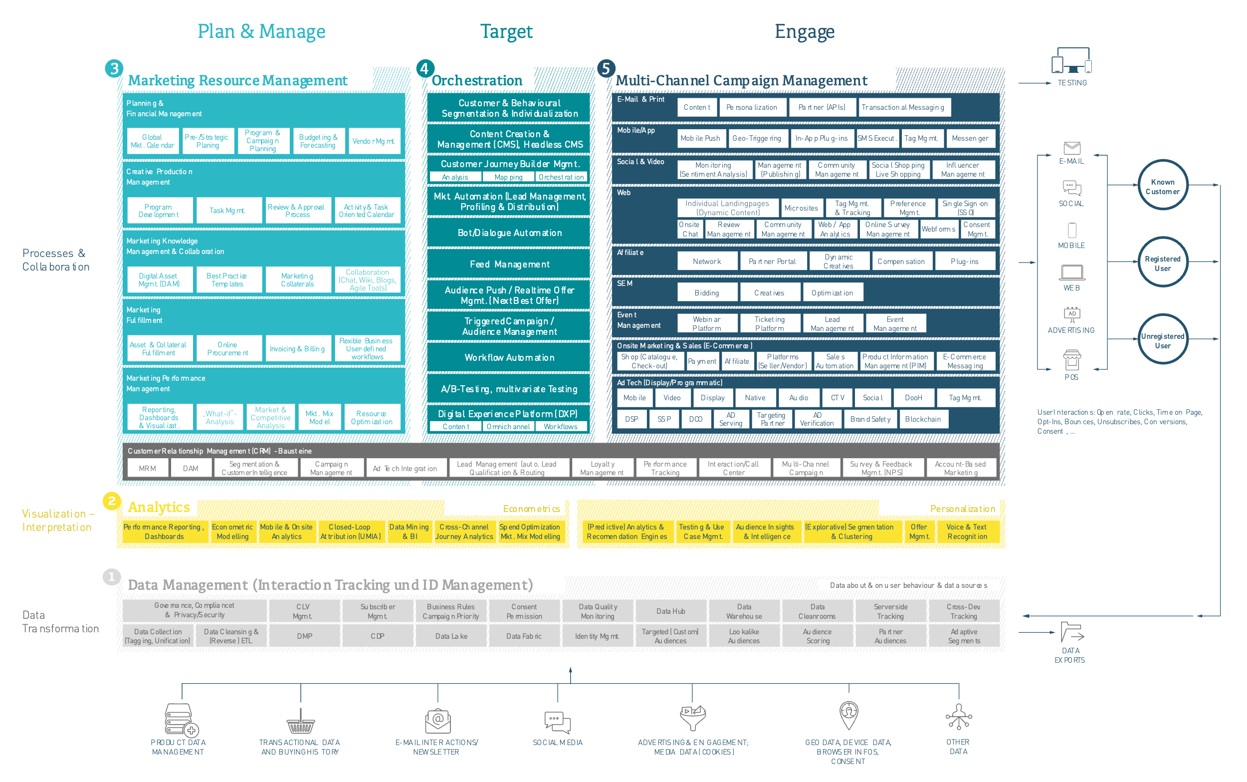
Example components of a marketing tech landscape by functions
Source: Marketing Tech Monitor 2022

Slide 17
Planning
Execution
Distribution
Measure
Reporting
Optimization

Slide 18
Collaborate
Create
Engage
Acquire
Analyze
Data Base

Slide 19
Example components of a marketing tech landscape by value creation
Source: brighttail, Stackie Awards 2020

Slide 20
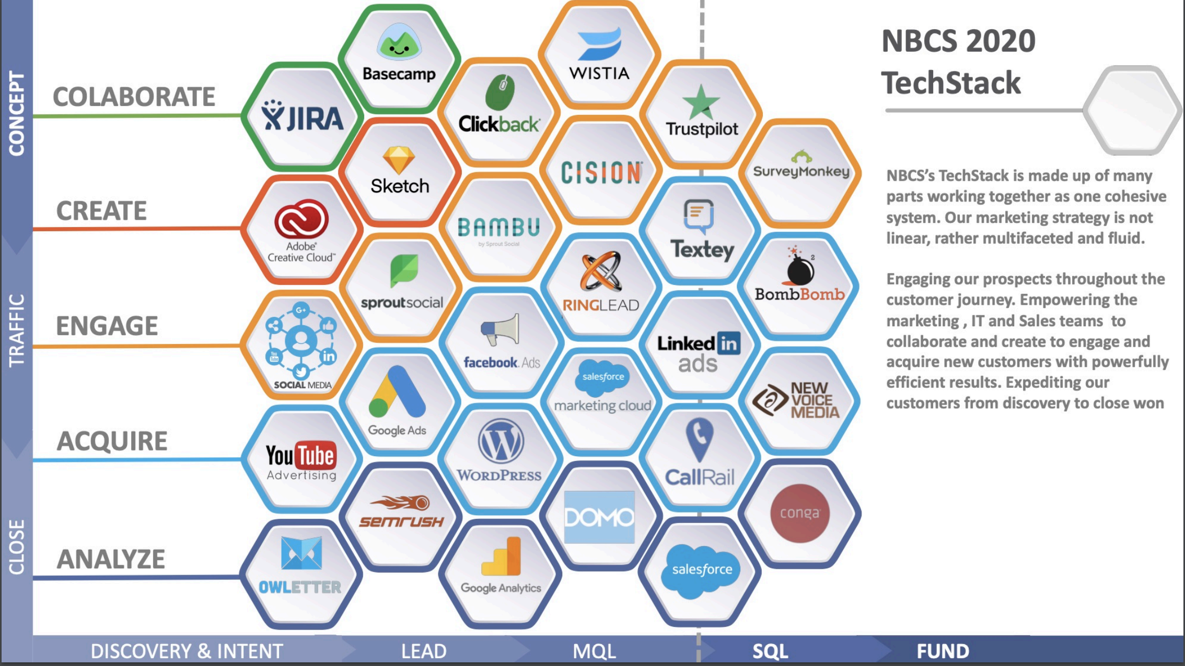
Example components of a Marketing Tech landscape by value creation
Source: NBCS 2020, Stackie Award

Slide 21
Aware
Shop / Buy
Install
Renew
Collaborate
Analyze
Data

Slide 22
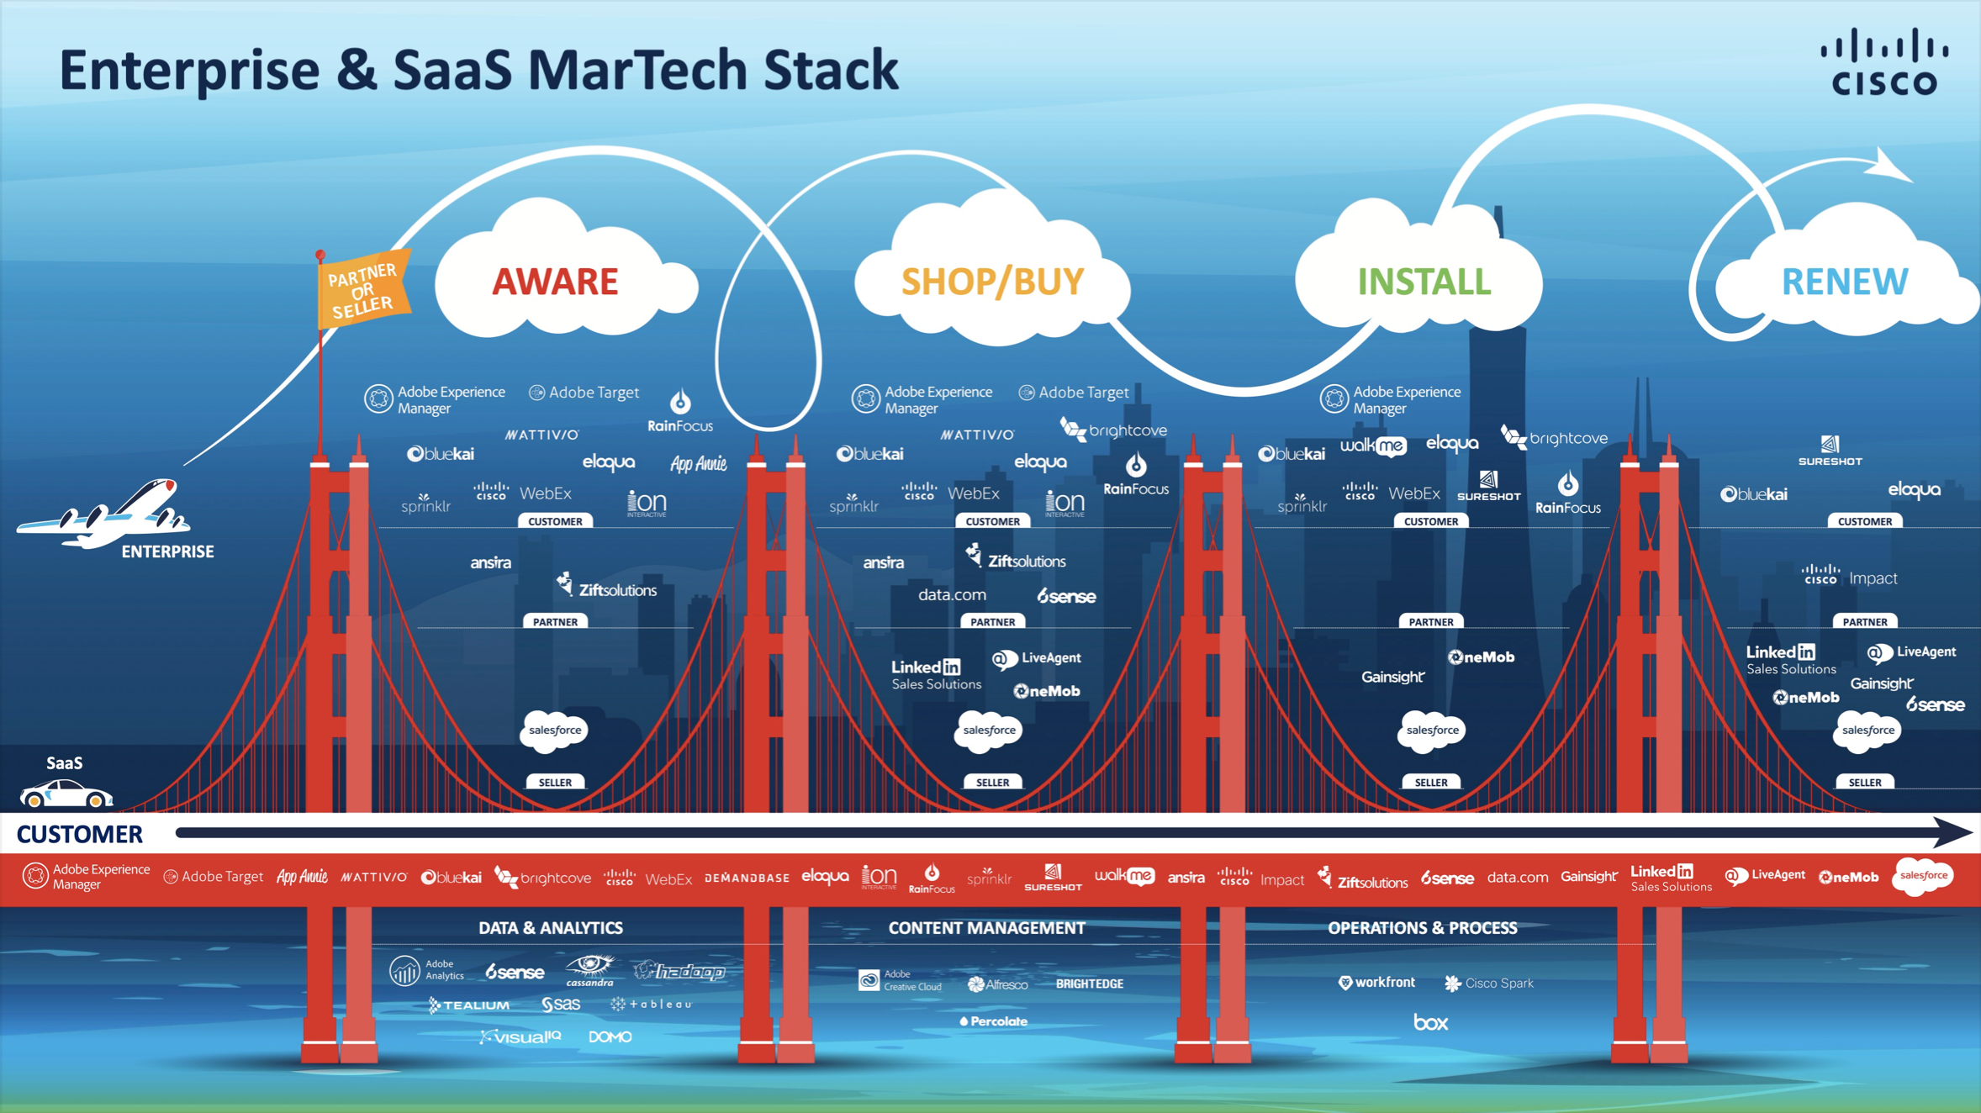
Example components of a Marketing Tech landscape by Customer Journey phases
Source: Cisco Systems, Stackie Award 2020

Slide 23
Data
Voice of the Customer
Analytics & Reporting
Optimization
Awareness
Convert
Service
Customer Engagement
Experience Management
Customer Funnel
Sales & Service
Content & Translation
Commerce & Market Places
Communities

Slide 24
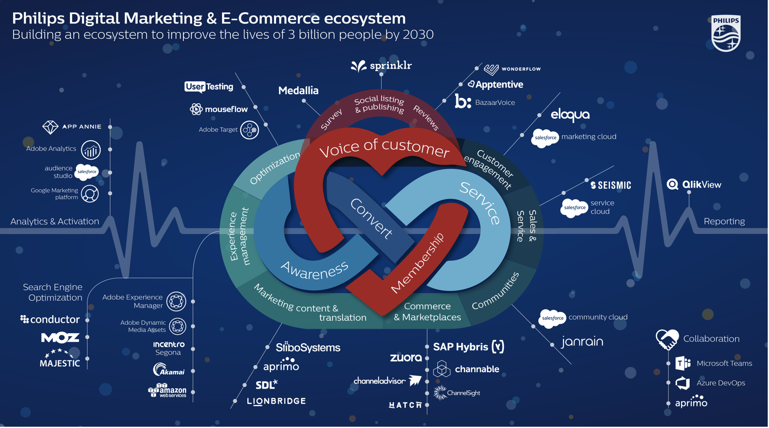
Example components of a Marketing Tech landscape by internal value creation and customer funnel
Source: Philips, Marketing Tech Monitor 2021, Stackie Award

Slide 25
Marketing Tech Award 2024
We are happy to assist you with any questions and suggestions regarding the Marketing Tech Award 2024.
Anja Ehrke
Senior Projektmanagerin Events
anja.ehrke@marketingtechlab.de
Phone: +49 (0)160 9069 2994
MarketingTechLab GmbH
Sierichstraße 8
22301 Hamburg
marketingtechlab.de

